Slide 2
Matthew 7:1-6
“Seeing Clearly,” Rod Thom

Slide 3
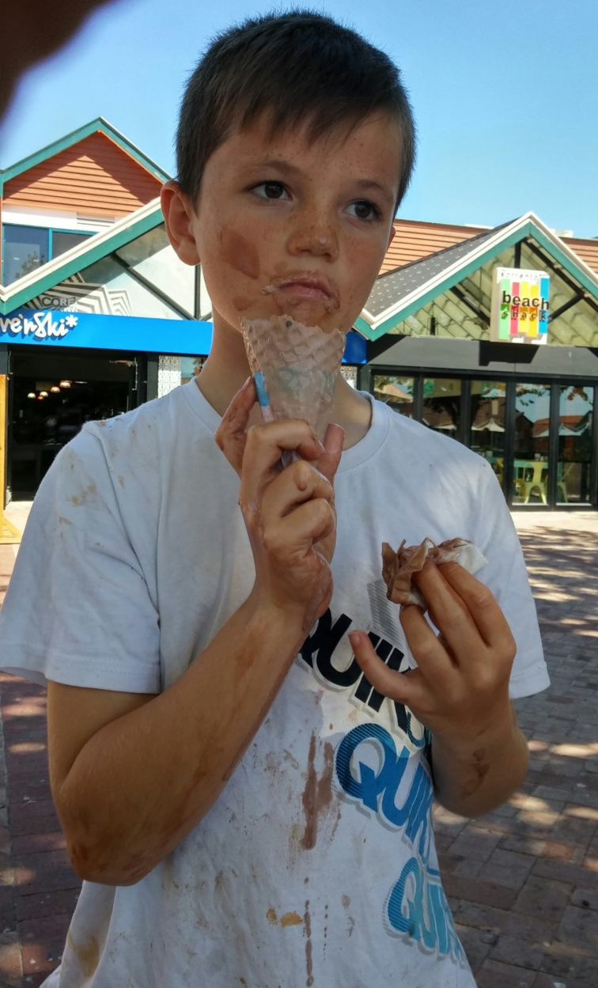
Seeing Clearly…

Slide 5
Matthew 7:1-6 (NIV)
1“Do not judge, or you too will be judged. 2 For in the same way you judge others, you will be judged, and with the measure you use, it will be measured to you.

Slide 6
Matthew 7:1-6 (NIV)
3 “Why do you look at the speck of sawdust in your brother’s eye and pay no attention to the plank in your own eye? 4 How can you say to your brother, ‘Let me take the speck out of your eye,’ when all the time there is a plank in your own eye? 5 You hypocrite, first take the plank out of your own eye, and then you will see clearly to remove the speck from your brother’s eye.

Slide 7
Matthew 7:1-6 (NIV)
6 “Do not give dogs what is sacred; do not throw your pearls to pigs. If you do, they may trample them under their feet, and turn and tear you to pieces.

Slide 8
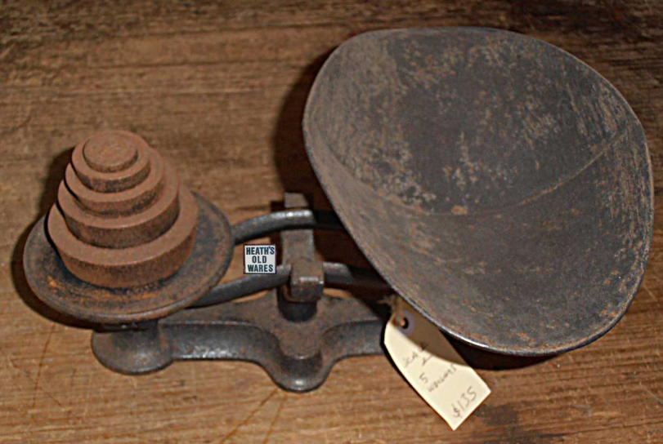
1. HYPOCRYTICAL JUDGEMENT
7:1 “Do not judge, or you too will be judged. 2 For in the same way you judge others, you will be judged, and with the measure you use, it will be measured to you.

Slide 9
1. HYPOCRYTICAL JUDGEMENT
3 “Why do you look at the speck of sawdust in your brother’s eye and pay no attention to the plank in your own eye? 4 How can you say to your brother, ‘Let me take the speck out of your eye,’ when all the time there is a plank in your own eye?

Slide 10
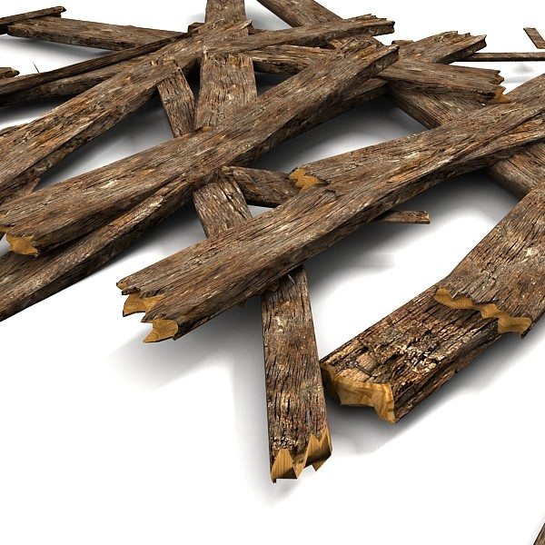
1. HYPOCRYTICAL JUDGEMENT
v5 You hypocrite, first take the plank out of your own eye, and then you will see clearly to remove the speck from your brother’s eye.

Slide 11
1. HYPOCRYTICAL JUDGEMENT
DEAL with your “own stuff” first
Psalm 139:(NIV)
23 Search me, God, and know my heart;
test me and know my anxious thoughts.
24 See if there is any offensive way in me,
and lead me in the way everlasting.

Slide 12
1. HYPOCRYTICAL JUDGEMENT
TEST your motives…
What’s your level of relationship?
Communicate with Humility and Love
If we are to stamp out HYPOCRITICAL JUDGEMENT in our lives and in our church, if we are to grow in our Kingdom Lives, we need to move from hypocrisy to humility.

Slide 13
2. Use WISDOM and DISCERNMENT as we proclaim the Gospel of the KINGDOM
6 “Do not give dogs what is sacred; do not throw your pearls to pigs. If you do, they may trample them under their feet, and turn and tear you to pieces.

Slide 14
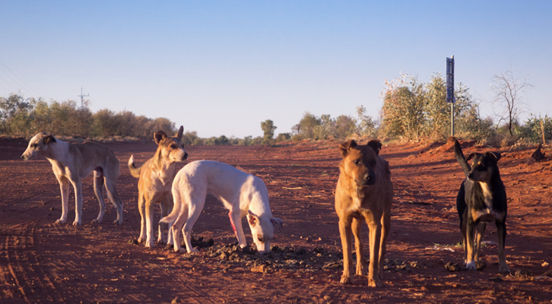
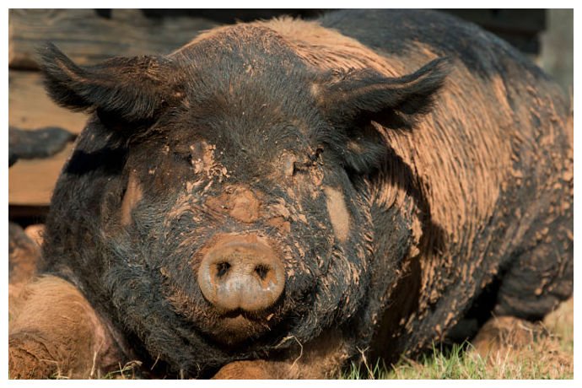
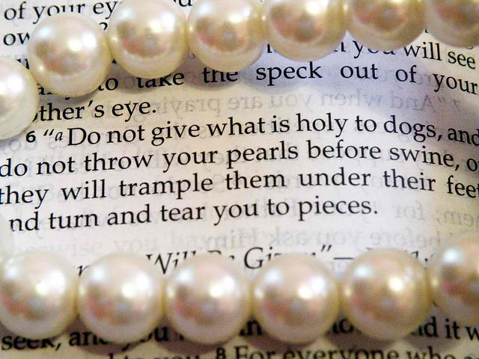
2. Wisdom and Discernment

Slide 15
2. Wisdom and Discernment
We need to Use WISDOM and DISCERNMENT as we proclaim the Gospel of the KINGDOM

Slide 16
Space to Reflect

